Slide 1
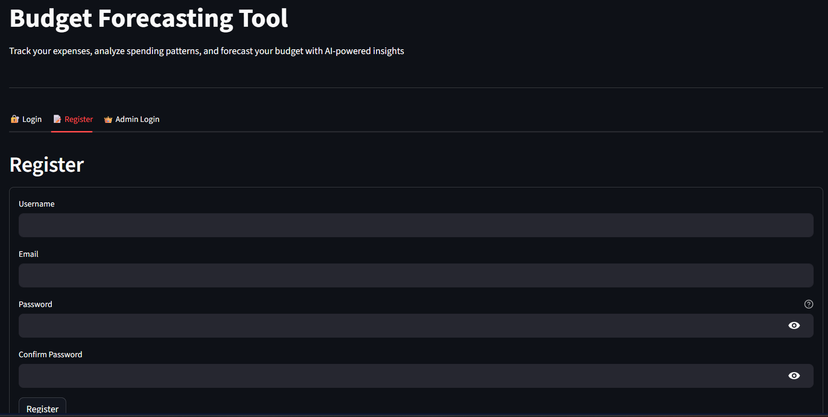
MILESTONE - 1
User registration:
This is the user registration form.
Here user can input his name mail id and password.
After giving all credentials he can click the register button.

Slide 2
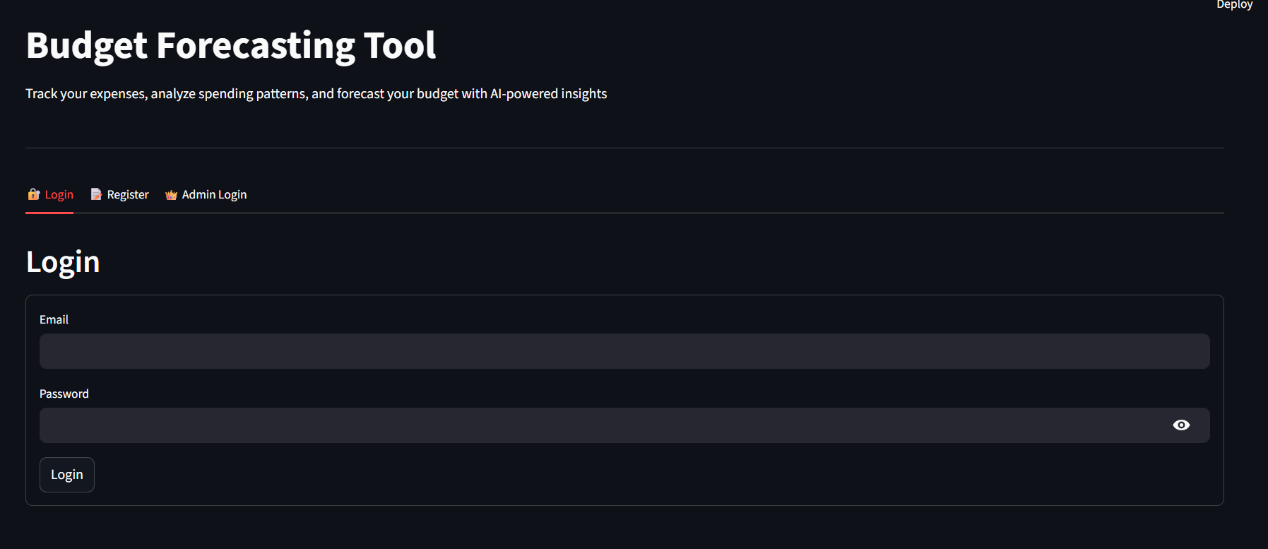
MILESTONE - 1
Login page:
This is the login page.
Here user input his mail id and password.
After giving the required credentials he can click the login button.
Now he can see the main dashboard.

Slide 3
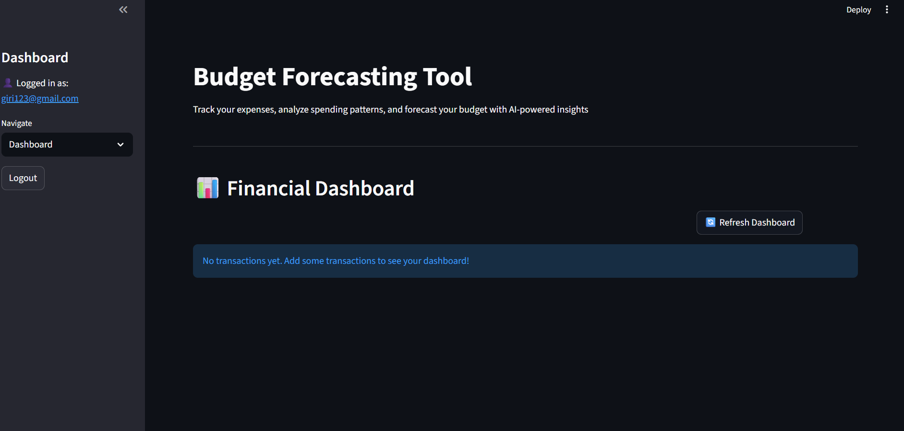
MILESTONE - 1
User dashboard:
This is the user dashboard page.
Here the user can manage his transactions.
I navigate section I have given a list.
I Navigation we can see Dashboard, Add Transaction, View Transactions, Budget reports.

Slide 4
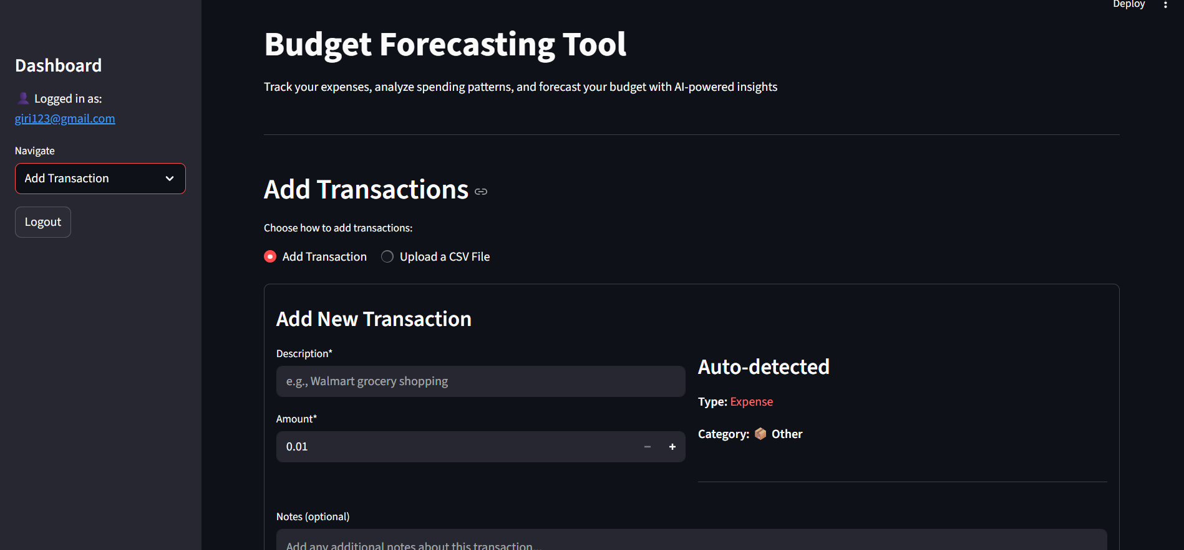
MILESTONE - 1
Here user can add transaction manually or upload a csv file.
User have to enter the description and amount.
Notes is optional where he can enter any more description about the transaction done.

Slide 5
Objective
Milestone 2
Transaction Categorization & Basic Reporting.
Develop features to categorize transactions automatically and generate spending reports.
The objective of this milestone is to develop features that automatically categorize financial transactions.
generate basic spending summary reports, and present data to the user.

Slide 6
Automated Categorization
The automated categorization system aims to classify transactions into categories such as ‘Groceries’, ‘Rent’, ‘Transport’, and others using rule-based or NLP.
Keyword matching techniques with the NLTK library can be employed to identify transaction types.

Slide 7
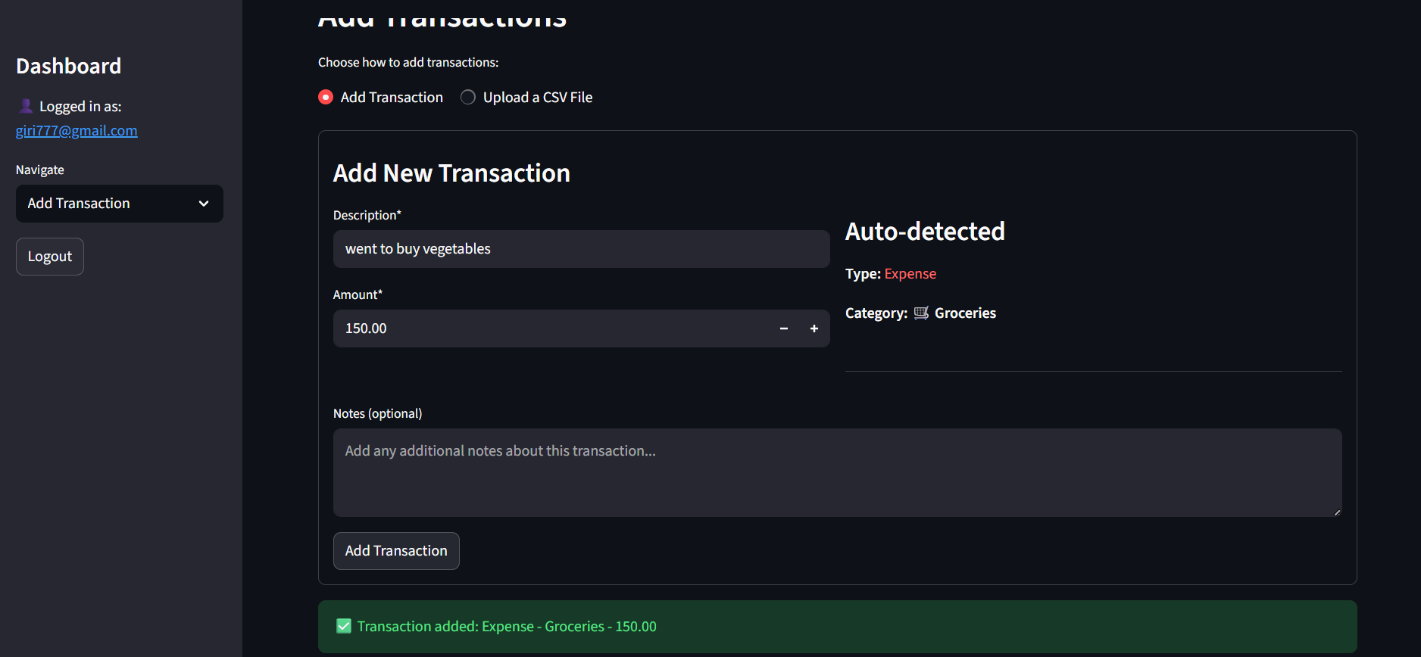
Here I have added the transaction when I click on the add transaction button the NLP will categorize accordingly to its category.
Here I have given description as went to buy groceries then amount after hitting the add transaction NLP will tokenize the given description and will decide the category.

Slide 8
NLP Implementation
Implement keyword-based NLP using NLTK.
Extract keywords from transaction descriptions and map them to predefined categories.
specific keywords in the transaction description map to predefined categories.

Slide 9
Spending Summary Reports
Use Pandas to generate reports on total spending, monthly summaries, and income vs expense analysis.
Category analysis done using pie chart using visualization tools like matplotlib and seaborn.
These provides a quick insight to an user so that he can estimate his future expenses.

Slide 10
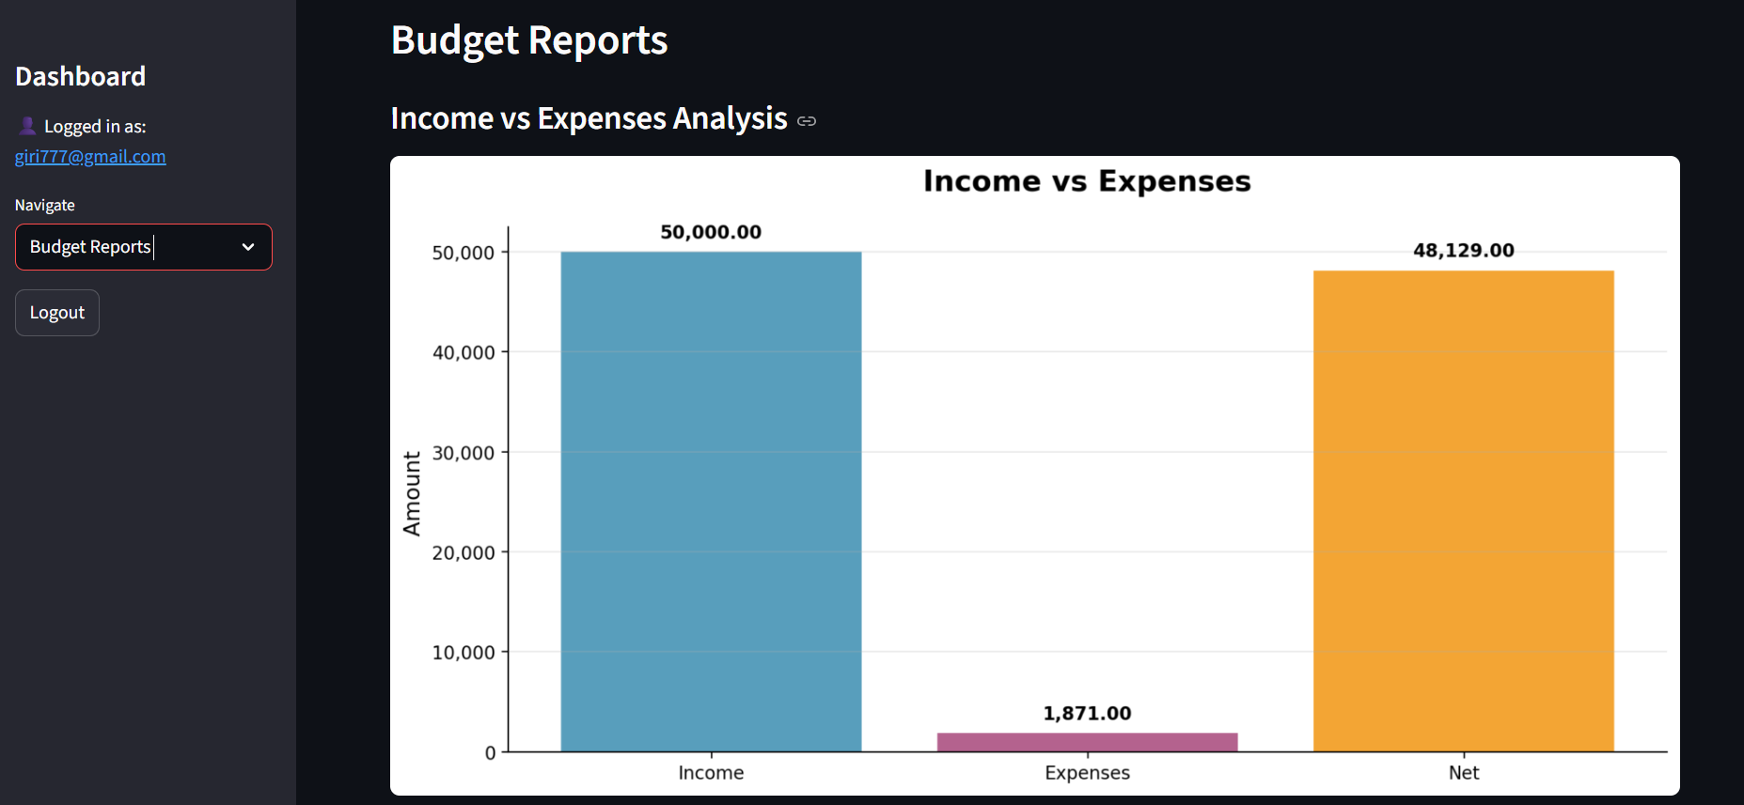
.
This is the budget report it shows the income VS expense fore cast I have done it using the matplotlib.
Here Income is the amount how much amount we have earned.
Expenses are the amount where he spent and the Net is the amount is the difference of the income and expense.

Slide 11
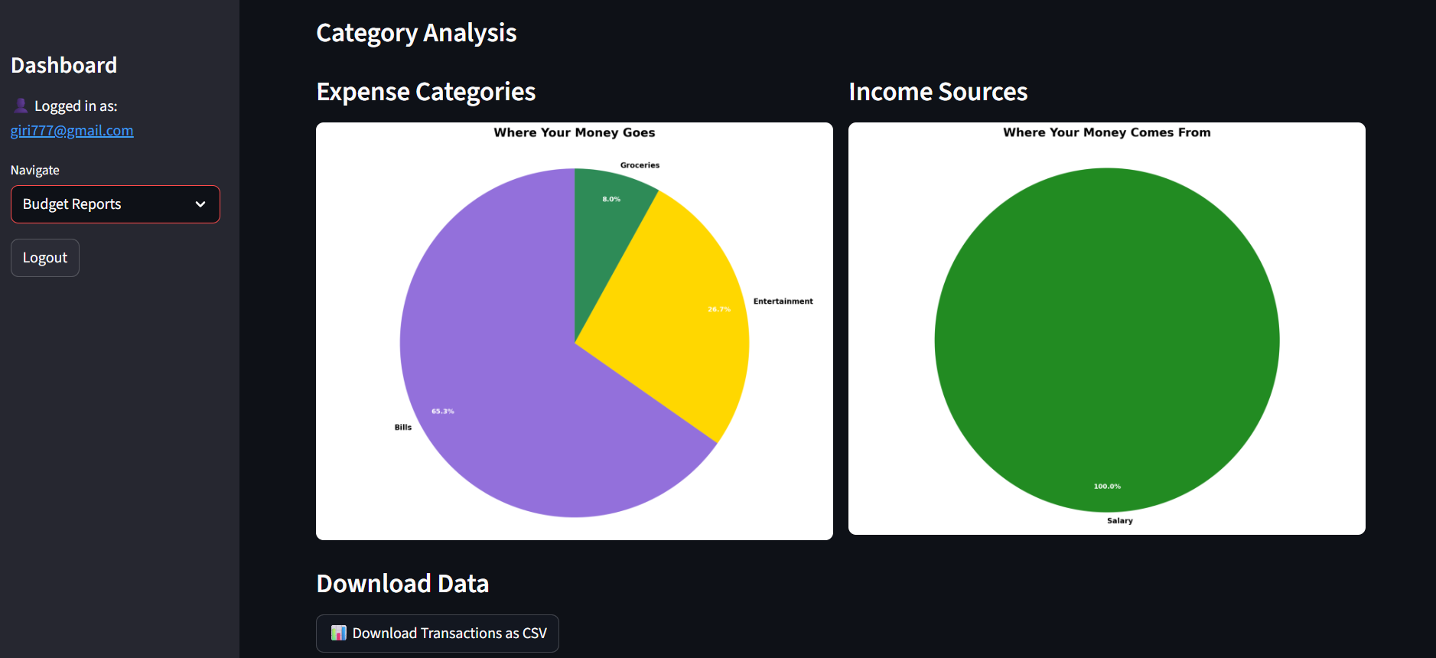
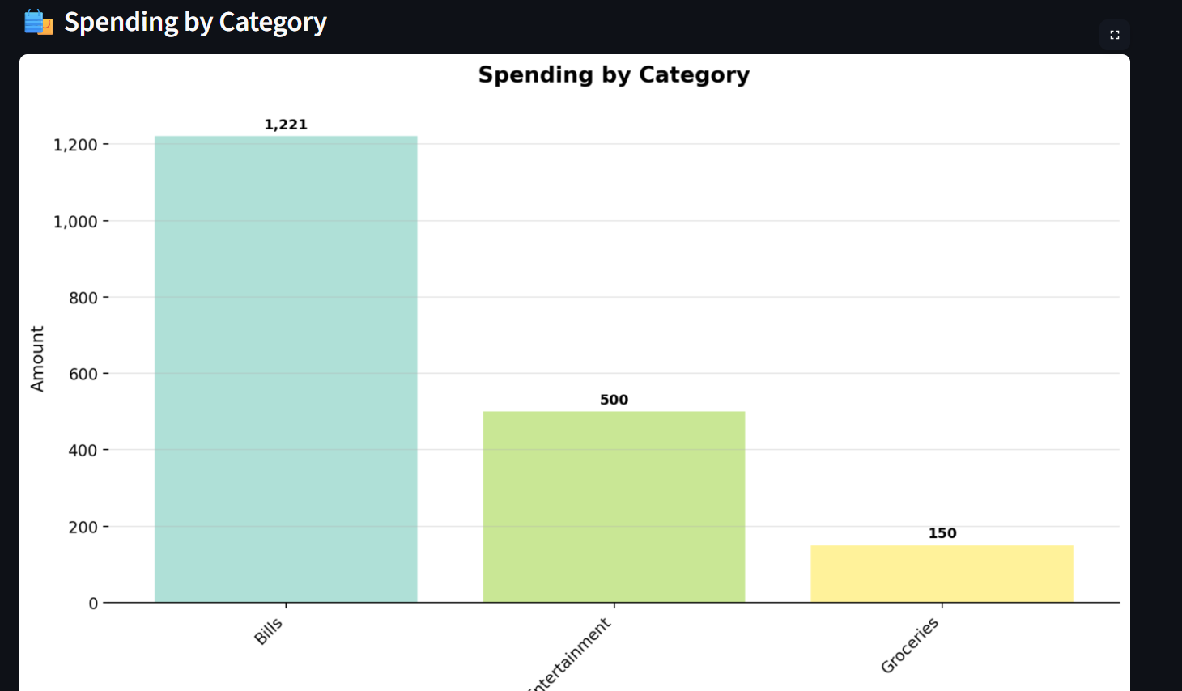
Report Features
Total spending per category
Income vs Expense over time
Expense categories
Income sources

Slide 12
Data Analysis Using Pandas
Perform data grouping, aggregation, and visualization for insights.
These summarized results will then be visualized through charts and graphs.

Slide 13
Visualization Tools
Use Matplotlib for creating visual summaries (pie/bar charts).
The primary tool is Matplotlib, used for creating the core line plots to visualize historical and forecasted trends.
These libraries work together to generate clear line charts , bar graphs, pie charts showing the budget forecast over time.

Slide 14
Expected Outcome
Automated categorization and reporting system that simplifies financial tracking and improves user insights.

Slide 15
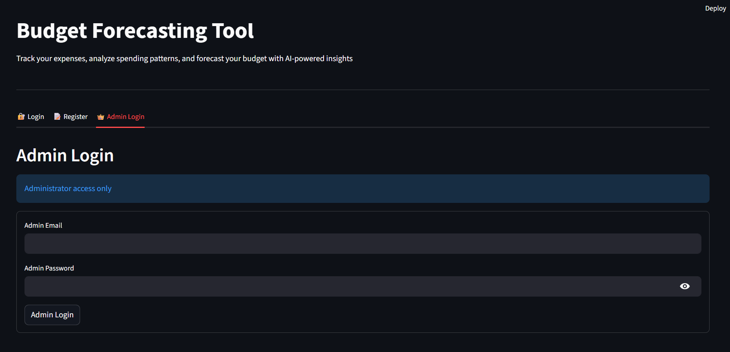
Admin Login
By using admin Login credentials an admin can be able to login.

Slide 16
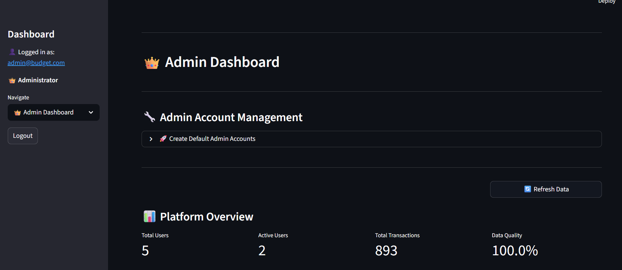
Admin Dashboard Overview
Control center for administrators
Monitor users, transactions &able to change the category.
Admin can see total
number of users &
active users .

Slide 17
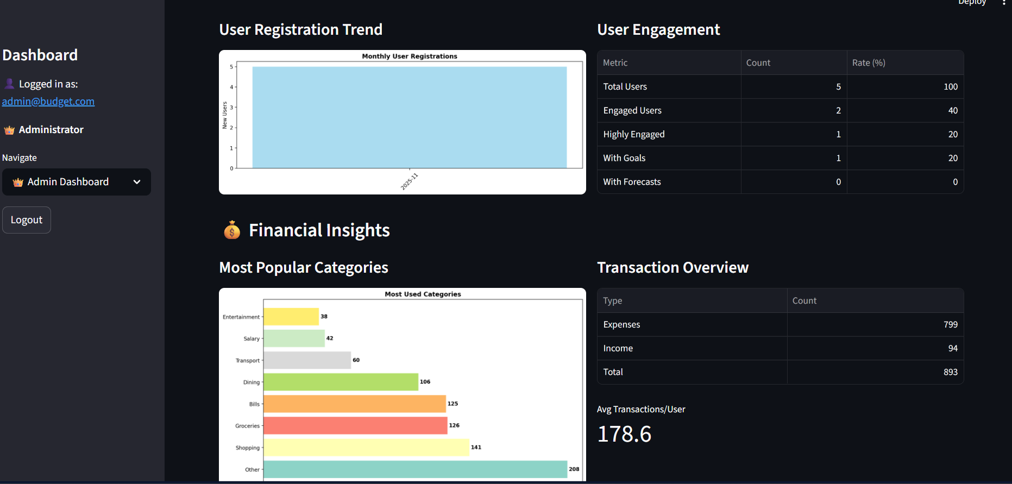
Platform Overview
Here
Here user can see top 10 transaction category where money has spent by user.
We can also see total number of Income & Expense categories.

Slide 18
Admin functions
Monthly registrations – Here admin can see how many transactions are done this month.
How many new user have registered newly.
Admin can see how many active users are there.
Active users are categorized like in past 30 days if he have logged in once then he is a active user.
I he hadn’t logged into our website in past 30 days then he is considered as inactive user.

